Slide 1
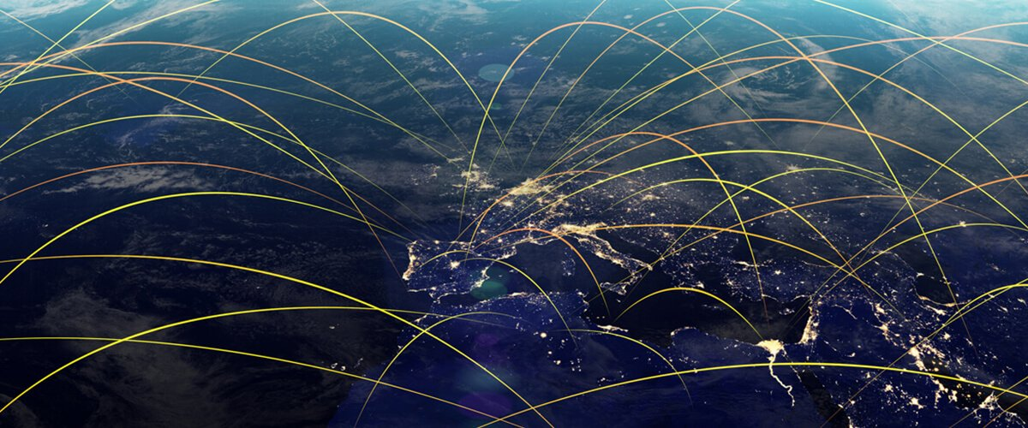
Analyzing the World Trade Network
Submitted by-
Aastha Arora A0178188L
Aishwarya Subash Chandra Bose A0178277M
Anjali Sinha A0178476L Chetna Gupta A0178260A
Misha Singh A0178309W
Zaira Hossain A0178331E

Slide 2
Introduction
Even before the emergence of topology sciences or graph theory, international trade has always been conceived as a network where trade flow is represented as a straight line between two points representing trading partners. Mutually intertwined supply chains in today’s contemporary economy have resulted in a complex network of trade relationships with a highly non-trivial topology that varies with time. In order to understand the complex interrelationships among different countries and economic sectors, as well as their dynamics, a holistic view on the underlying structural properties of this network is necessary.
Objectives -
Use Graph/Network mining techniques to:
Identify Key Players in the Global Trade Network
Identify sub-networks or communities with dense intra trade flow
Identify rising stars or evolution of key-players over time
Identify if & how internal disturbances impact the overall trade flow and global trading prominence of a country or it’s partner nations.
Data Source -
UN Trade Statistics: https://unstats.un.org/unsd/trade/data/tables.asp#quarterlyindices
BACI CEPHII:
https://db.nomics.world

Slide 3


Tools Used
Gephi
Advantages of Gephi
Platform robust (PC, Mac, Linux)
Open source
Usable for both simple and complex networks
Attractive visualizations
No coding required
Disadvantages of Gephi
Works best for single nodal/edge types
Less flexible and nuanced than coding languages such as R
Input-data preparation & formatting can be time consuming
R
We also tried using R programming but faced the below issues
R takes a long time to process the code as compared to the Gephi software and cannot handle large networks
Each node of the network needs to be programmed which is a tedious task, also take a long time and needs high level programming skills
It is less user-friendly than a point and click program
Visualization needs to be beautified and not as visually attractive as Gephi

Slide 4
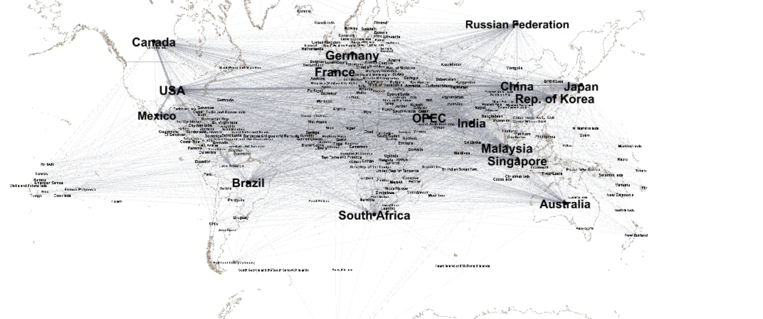
The Complete World Trade Network
240 nodes 3149 directed edges
Network Diameter = 2
Every country on the network is connected to every other country through a maximum of 1 intermediate node.
Average Path Length = 1.177
Average no. of nodes to be traversed in order to get to any 1 country from any other country.
Hence, It is a Dense Network, validating the concept of Globalization.
Settings Applied-
Node Size = Weighted Degree
Edge Size = Weight ($ value of trade volume)
Layout = Geolayout + Map Countries Layout

Slide 5
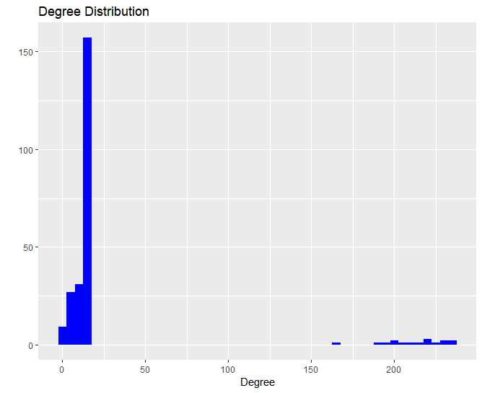
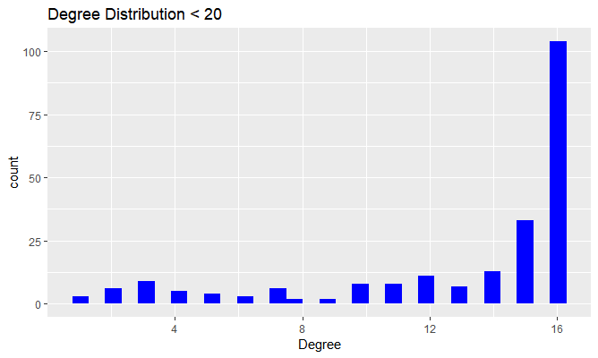
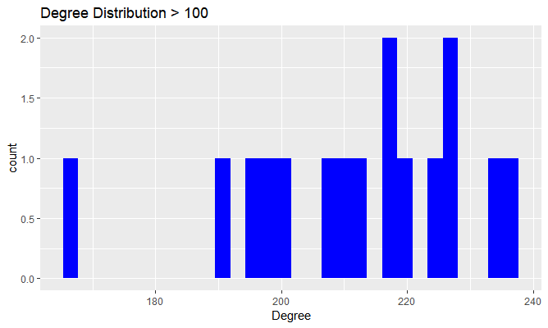
Network Structure
The distribution of degrees within the network is highly skewed.
Out of a given total of 240 nodes:
Majority of the nodes have degrees between 1 to 16
Remaining 16 nodes have degrees greater than 150
There exist no nodes with degrees between 20 to 150
Thus, though the network appears to be dense, it is only the top 16 nodes that act as connectors.
Removal of these key players would result in a sparsely connected disjoint network.

Slide 6
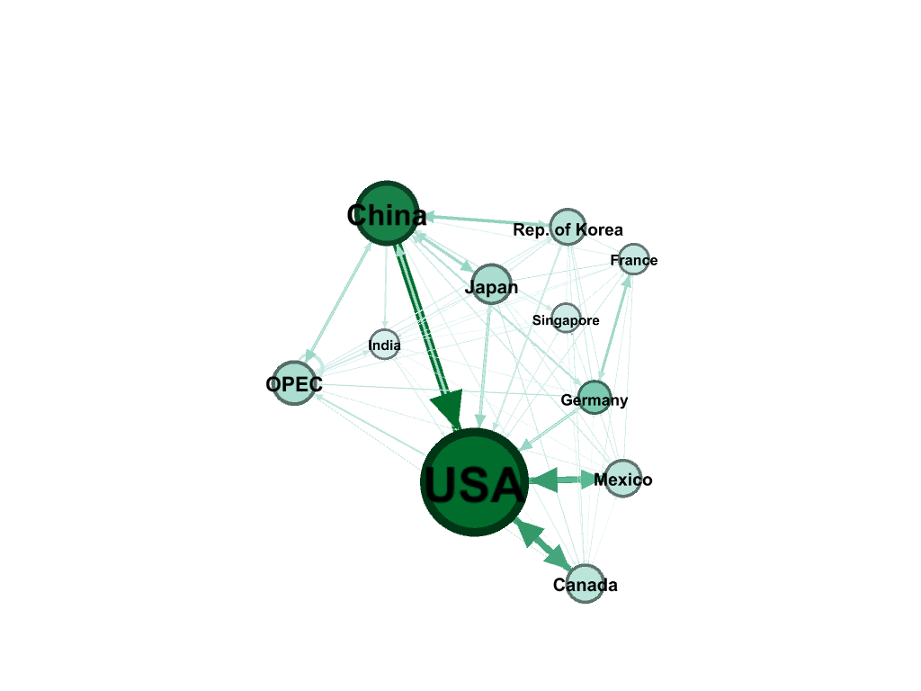
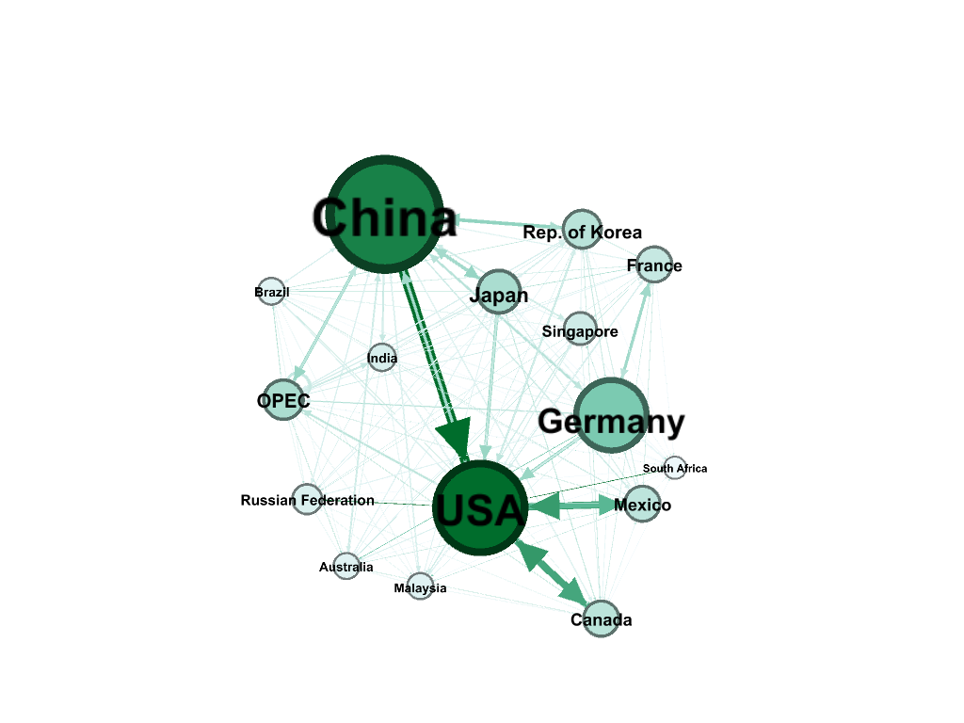
Key players
Weighted in degree
Those nations whose economies govern most of the global trade by virtue of being large consumers/producers or being centrally located. Hence any impact to their economies can drastically impact global trade flow and in turn the economies of small nations which are dependent on these nations for either resources or revenue.
Imports-
based on Weighted In-Degree
USA is the biggest importer
Closely followed by China & other countries
Exports –
based on Weighted Out-Degree
China is the biggest exporter
Closely followed by USA & then Germany
Weighted out degree

Slide 7
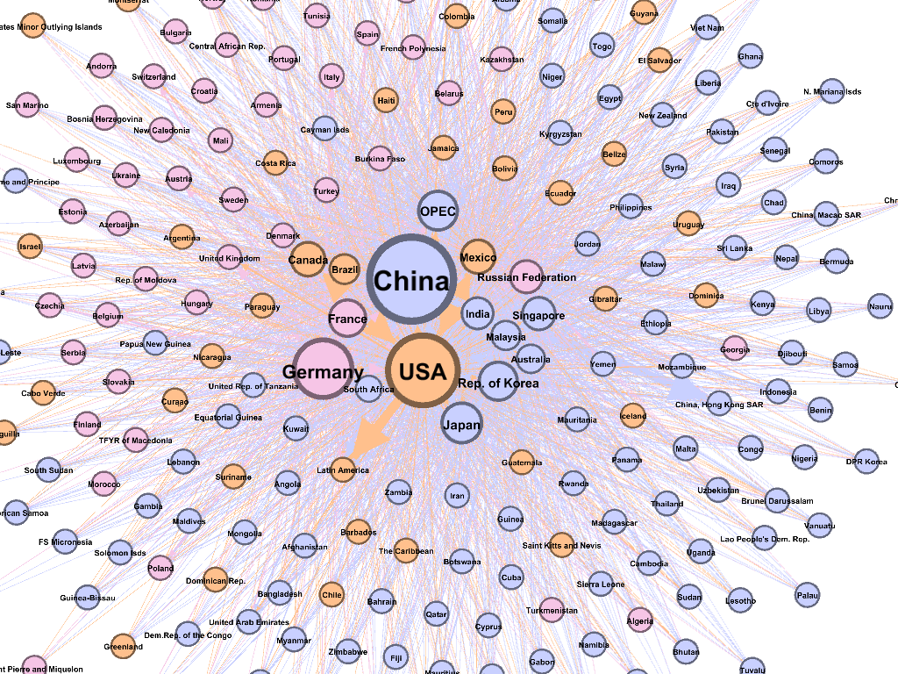
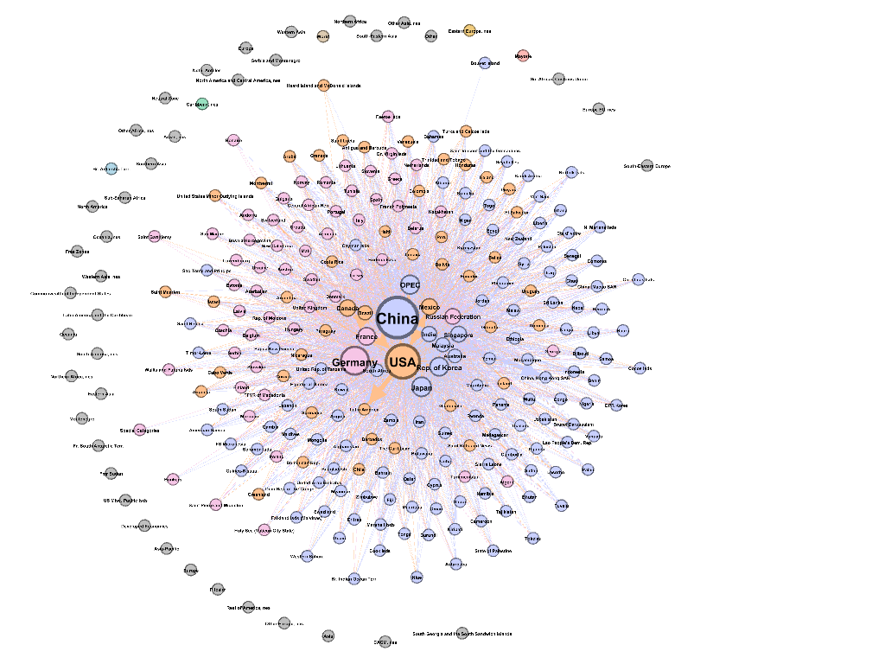
Community Detection
Louvian Modularity Community Detection Algorithm -
Optimizes the “ weighted modularity" of a partition of the network.
The optimization mechanism follows a 2 step approach as follows:
i) The method looks for "small" communities by optimizing modularity locally.
ii) It aggregates nodes belonging to the same community and builds a new network whose nodes are the communities.
3 key communities identified
Settings Applied-
Node Size = Weighted Degree
Node Colour = Partitioned by Modularity
Edge Size = Weight ($ value of trade volume)
Layout = Fruchterman Reingold + No-overlap

Slide 8
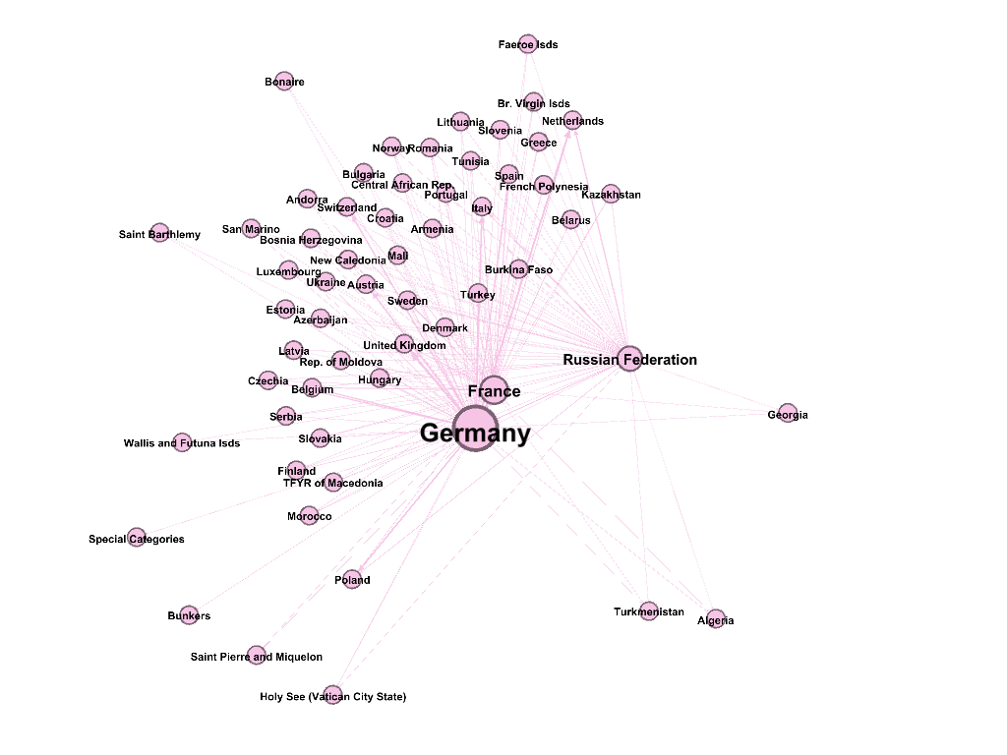
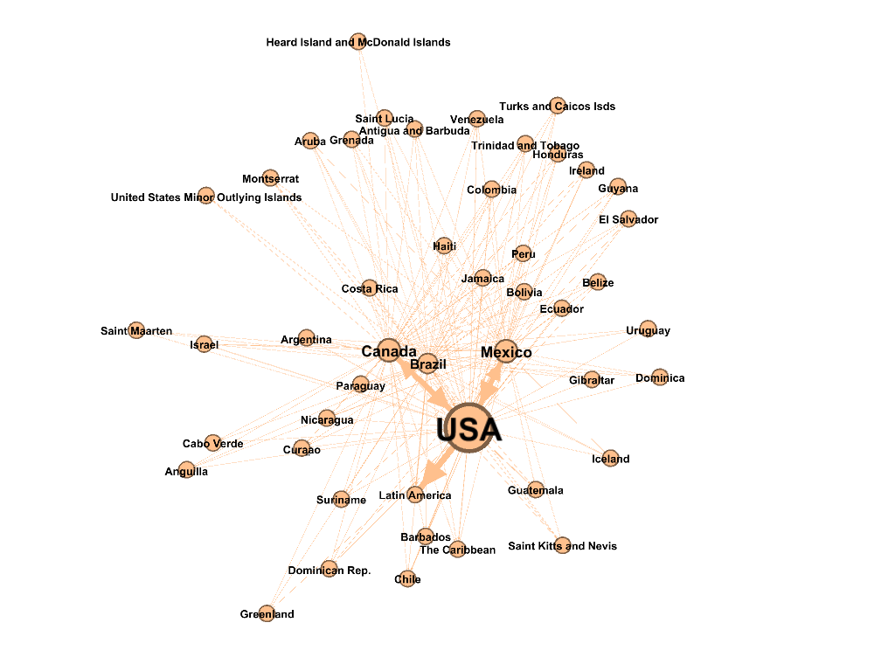
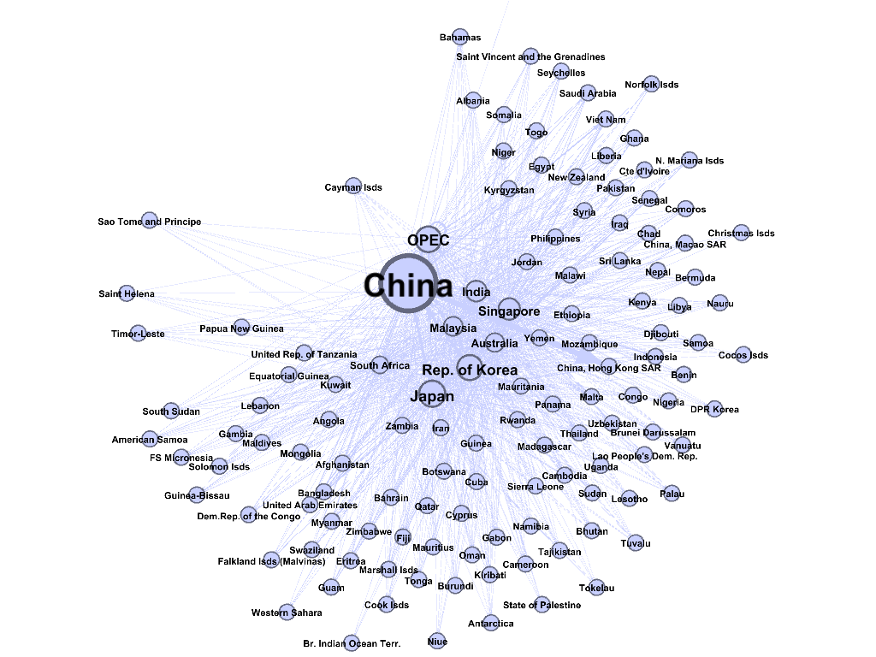
Individual Communities
Resultant communities emerge to have some geographic distinction between them.
Countries from the same continent get assigned to the same community, implying that:
Trade density is higher between countries of the same continent
This could be due to the fact the close proximity of neighbouring countries allows for cheap transportation, hence encouraging trade.
European Cluster
Modularity = 0.21
Key Players :
Germany
France
Russia
American Cluster
Modularity = 0.16
Key Players :
USA
Canada
Mexico
Asian Cluster
Modularity = 0.45
Key Players :
China
Oil Producing Economies
Korea
Japan

Slide 9
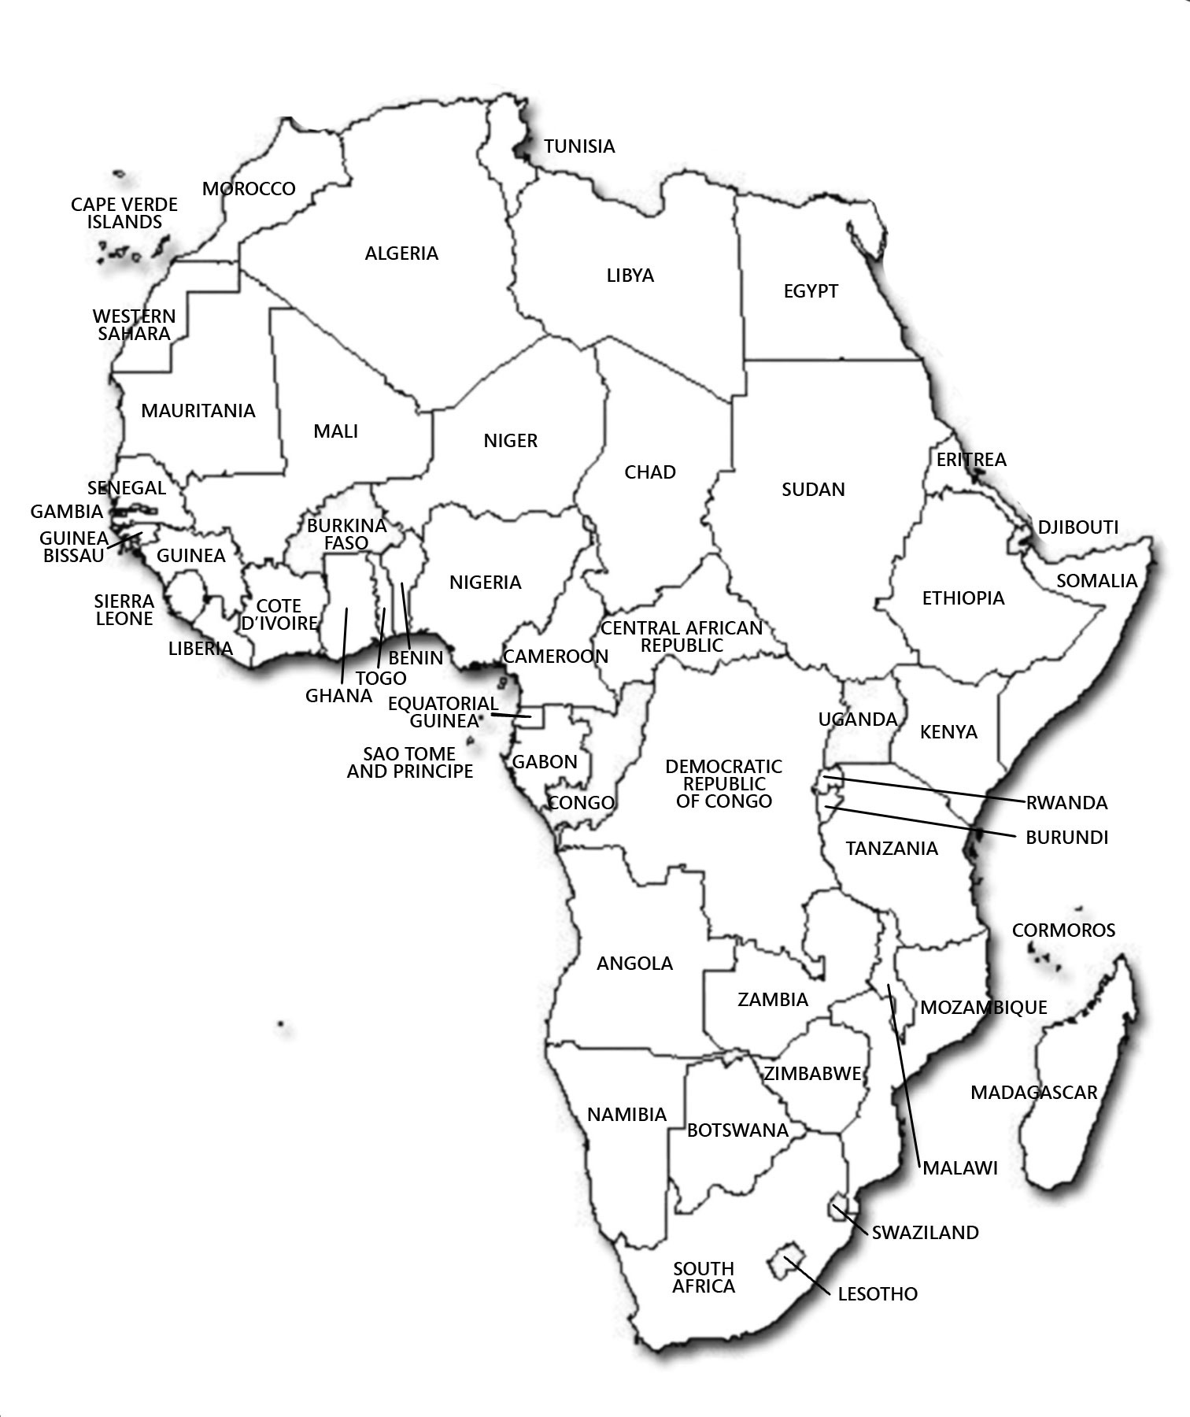
Exceptions to the “Continent based Community” description
Exceptions-
Western & Central
African Countries
Morocco
Algeria
Central African Republic
Exceptions-
Eastern African Countries
Egypt
Ethopia
Kenya
Swaziland
Located closer to Europe (just below it)
Transport must be easier resulting in denser trade with European countries. Thus assigned to European community
Located closer to Asia (adjacent to it’s west) Transport must be easier resulting in denser trade with Asian countries. Thus assigned to Asian community

Slide 10
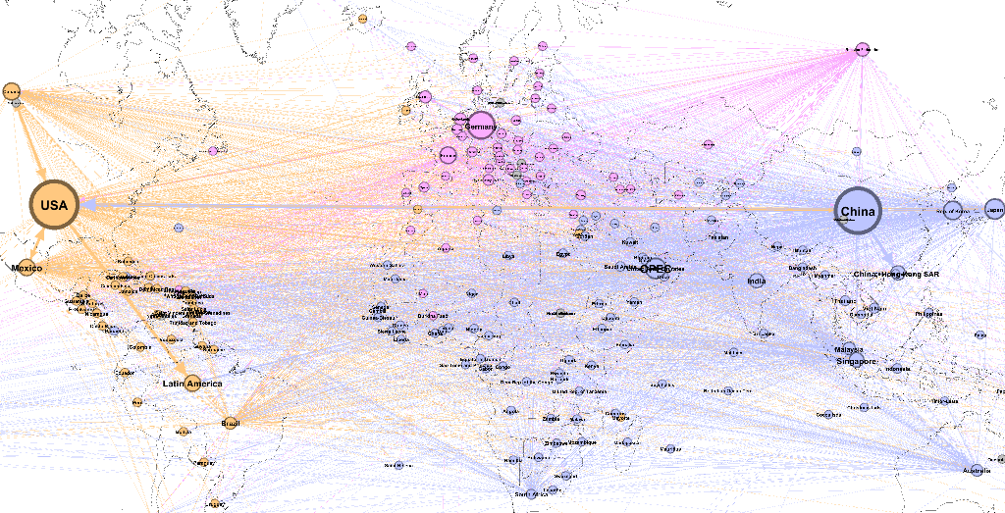
Geographic Layout of Communities

Slide 11
Dynamic Trade Analysis

Slide 12
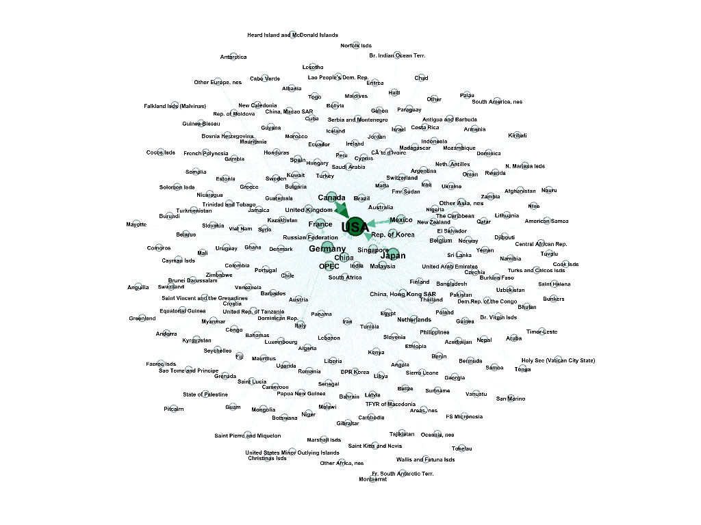
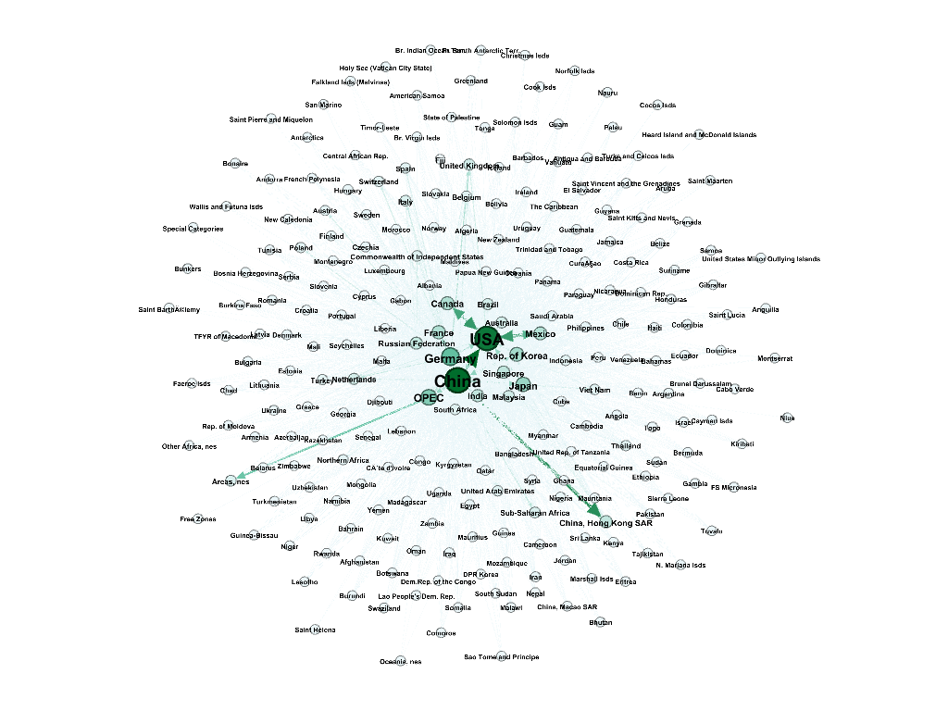
Dynamic Analysis
Key Observations:
China has grown massively in the past 15 years to come at par with USA as a key trading center, by gaining prominence not only in terms of trade value but also in terms of no. of trading partners.
European countries like Germany and France have retained their importance as central to the global trade network, owing more to their interconnectedness than size.
Korea & India have shown steady rise in their trade values and connections to emerge with increased importance as trading centers.
2000
2015

Slide 13
Impact of Crisis
Japan’s 2011 Triple Disaster:
In 2011, Japan was hit by an Earthquake which resulted in a Tsunami and a Nuclear Disaster.
Key Observations –
Japan’s Export Partners decreased since the Out-Degree declined while the In-Degree remained almost the same
Caused due to Japan’s Inability to produce quality goods (specially agriculture) at the same pace as before.
Also countries like USA reduced imports from Japan due to fear of nuclear contamination
Net imports increased as contrary to anticipation, the Weighted In -Degree increased.
Caused due increase in Oil imports using oil as an alternate source of power generation during the nuclear shutdown.
Decline in prominence as a Trading Center
Closeness Centrality declined i.e. the avg length of the shortest path between Japan and any other nation declined.
Eccentricity increased from 2 to 3 i.e. the maximum no. of intermediate nodes to be traversed to reach any other country from Japan, increased from 1 to 2.

Slide 14
Commodity Specific Trade Analysis

Slide 15
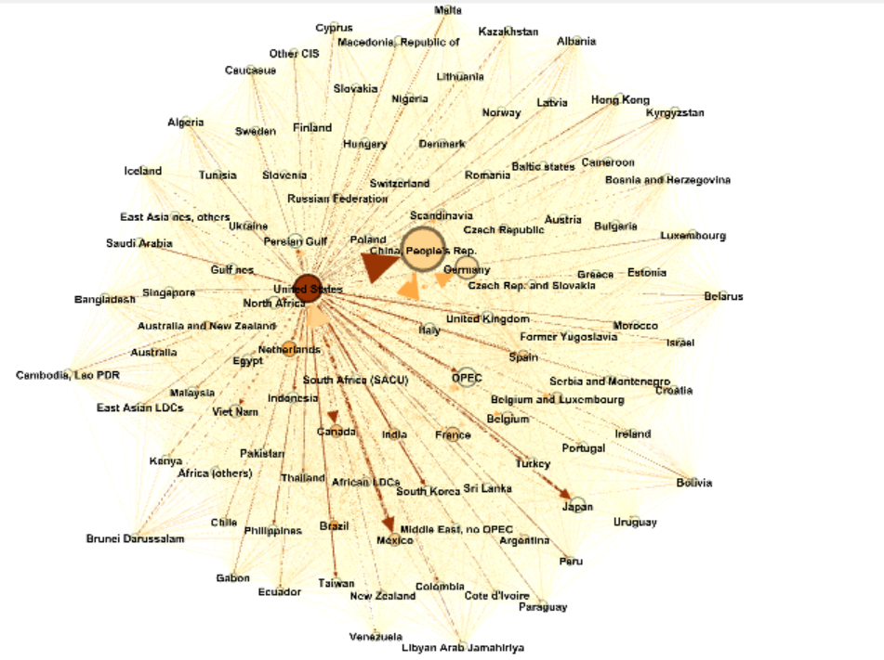
Agriculture Trade
Agriculture is a commodity that depends on the land area and labour thus the trade network comprises of counties like:
USA
China
Germany
Netherlands
India, etc. as key players
The node color intensity in graph depicts the volume of trade
Connected Components = 1, implying that agriculture as a trade is self-sustaining.

Slide 16
Agriculture Trade Network
Asia Pacific Cluster: China, USA are major traders. OPEC and Japan etc are only inporters
South Asian Cluster: India and Bangladesh are major exports and Gulf region are major importers
European Cluster:
Germany ,Netherlands & France are major traders

Slide 17
Oil Trade
The oil export network has key players like the OPEC Nations, Persian Gulf Africa and Middle east
Major Importers-Asia and Oceania, North East Asia, India, Japan
Russia plays a central role in the European trade system
Kazakhstan acting as a secondary hub in Central Asia. The country acts as a bridge between Europe an China. China has been investing heavily in Kazakhstan’s oil and in the country’s infrastructure, including pipelines, highways and rail roads, and refineries. China’s purchases of Kazakhstan’s oil, gas and minerals has booming, and Hong Kong is the gateway to China.
Latin American countries appears as composed of two separate cohesive sub-groups. On one side, Venezuela ,Mexico , Ecuador coordinate the northern cluster. Brazil ,Argentina and Colombia coordinate the southern one, both groups of leading countries keep the intra-continent trade connected and they also link the continent to the rest of the world.

Slide 18
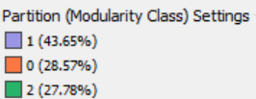
Oil Trade Network

Slide 19
Automobile Engine Trade
Key Players
Germany
Japan
USA
Asian Key Players : South Korea, Thailand, Singapore
European Key Players: UK, France, Spain
China is a key player overall, but here we see that China is nowhere near the key players.

Slide 20
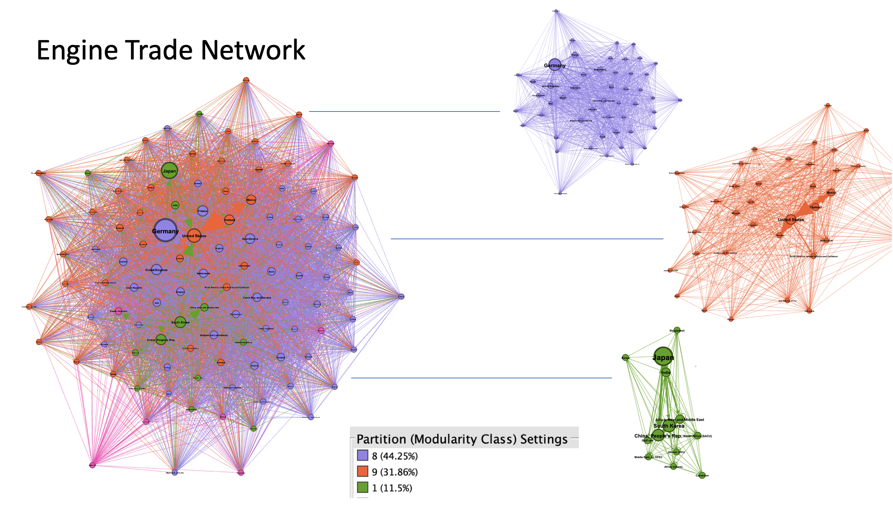
Automobile Engine Trade Network

Slide 21
Conclusion

Slide 22
Insight Summary
Business Insights -
The Global Trade Network is a densely connected network of countries dominated by mostly 16 countries.
USA has continued to retain its prominence as a Key Player globally.
In the past decade China has dramatically risen to dominate the global trade markets, outshining USA in terms of exports.
Since it is a highly connected network, not many communities can be separated out.
Trade quantities & connections are higher between closely located countries, hence communities formed have a geographic distinction at the continent level.
Any socio-economic disturbances in a country such as occurrence of a disaster or even social unrest can impact its position as a key-player. This in-turn, can further impact the trade and the economy of very small partner countries.
Tool Insights -
Gephi provides only 1 weighted community detection algorithm that is based on Louvian Modularity
Gephi provides a dynamic network feature which is meant to update the network parameters and animate its appearance based on an time interval parameter. However this dynamic feature is incapable of computing weighted network attributes at a dynamic level and only produces aggregate weighted values for the entire timeseries
There exists no layout feature to separate out communities based on Modularity.

Slide 23
Future Work
Creation of a dynamic timeline that covers the changes in the volume of trade month wise over a long period of time
Carrying out network analysis for other important commodities and sub commodities
Conducting analysis after normalizing trade value by GDP for each nation, in order to deduce a nation's reliance on trade.
Building a model to estimate the impact of a crisis on the trade flow of a nation and its allied partners
Create a machine learning model to predict the export value over the coming years based on the historic data

Slide 24

Thank You!

